Slide 1


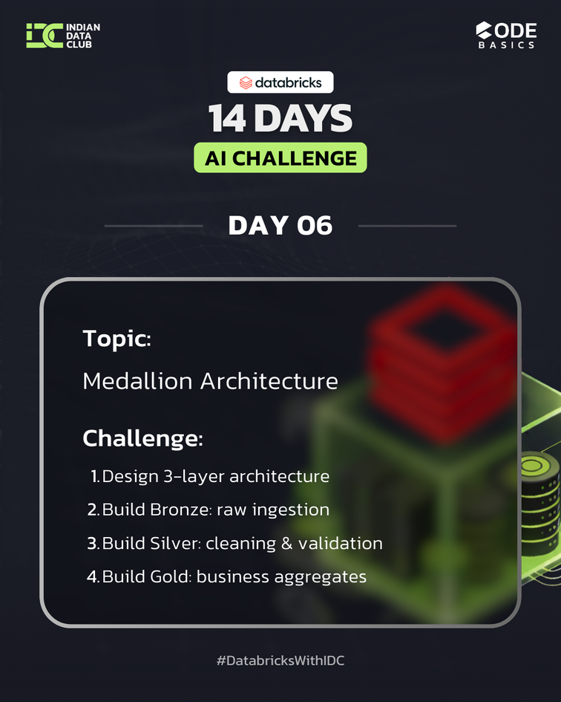
DAY 06
Medallion Architecture
Building a 3-Layer Data Pipeline with Databricks
Presented by: Ruchi Wange
In Collaboration With: Databricks | Codebasics | Indian Data Club
Notes:
1

Slide 2

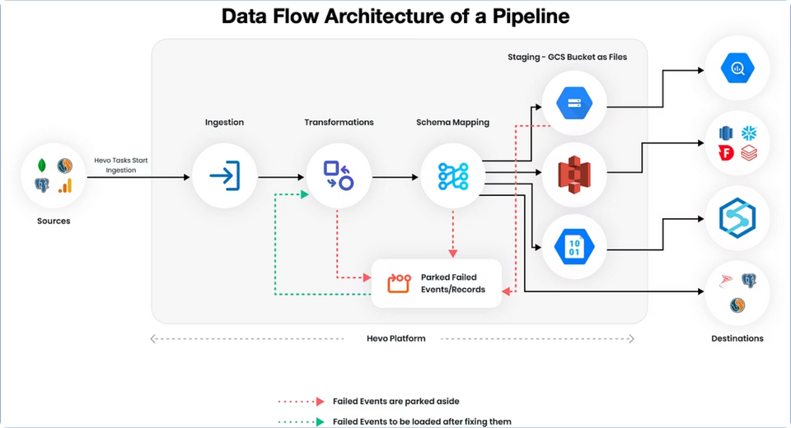
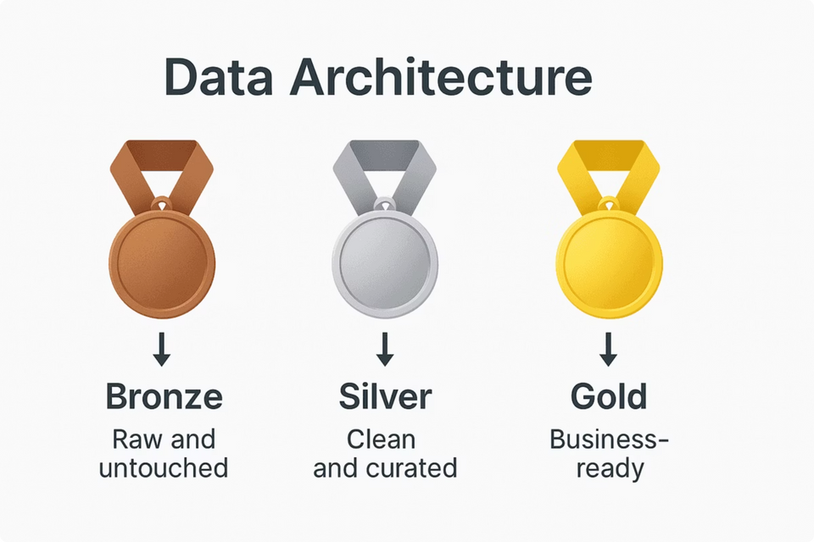
What is Medallion Architecture?
Bronze Layer
Silver Layer
Raw data ingestion from source systems with minimal transformation
Cleaned, validated, and deduplicated data ready for analysis
Gold Layer
Business-ready aggregations and insights for reporting
Notes:
2

Slide 3
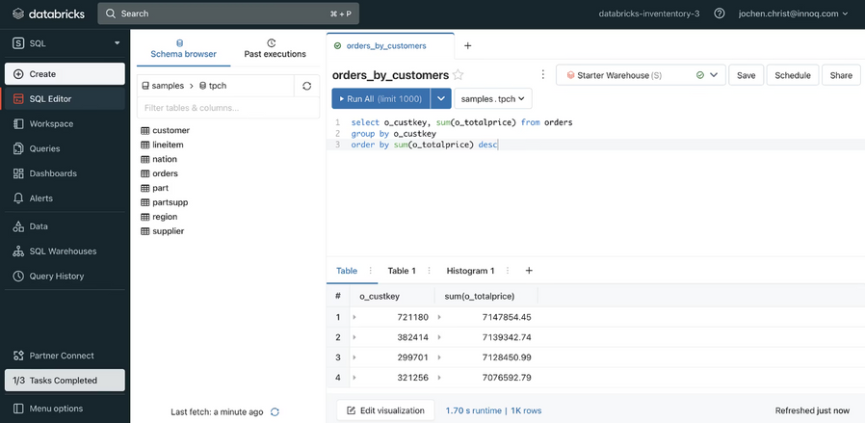
Project Overview
E-commerce Dataset
Real-world e-commerce data from November 2019 containing user behavior, product categories, and transaction details.
Technology Stack
Databricks workspace
Delta Lake format
PySpark for transformations
SQL for validation
Notes:
3

Slide 4

BRONZE LAYER
Raw Data Ingestion
01
02
03
Read CSV from Volume
Create Bronze Table
Verify Data
Load raw e-commerce data from /Volumes/workspace/ecommerce/ecommerce_data/2019-Nov.csv
Write data to Delta format as medallion_db.bronze_2019_nov
Query the Bronze table to confirm successful ingestion
Notes:
4

Slide 5


SILVER LAYER
Data Cleaning & Validation
Remove Duplicates
Handle Null Values
Apply dropDuplicates() to eliminate redundant records
Filter out records with null user_id or price fields
Validate Business Rules
Save Clean Data
Ensure price values are greater than zero
Write to medallion_db.silver_2019_nov as managed Delta table
Notes:
5

Slide 6
Silver Layer Transformation
Input: Bronze Data
Output: Clean Data
Raw, unprocessed records with potential quality issues
Validated, deduplicated records ready for analysis
Notes:
6

Slide 7
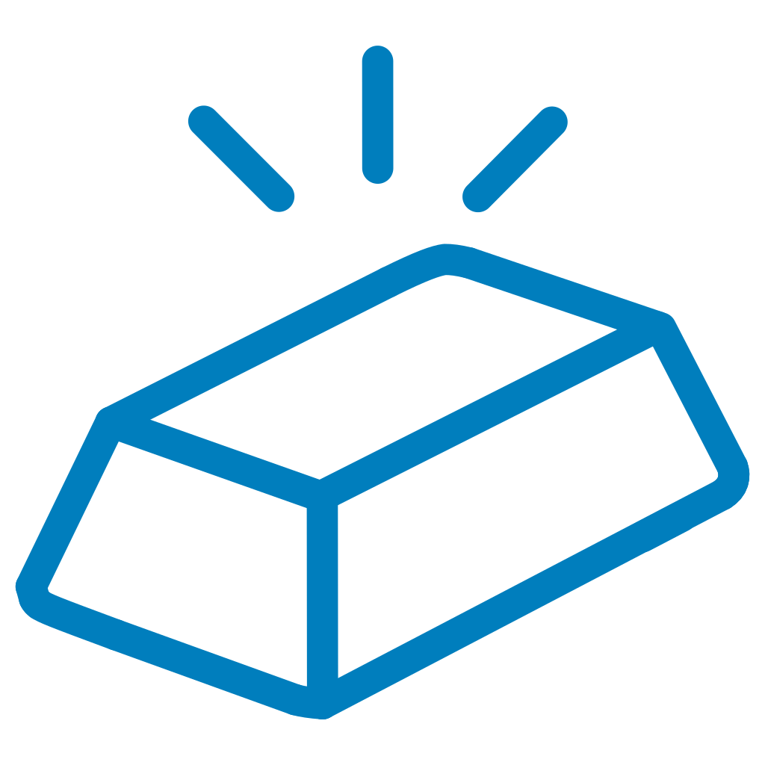
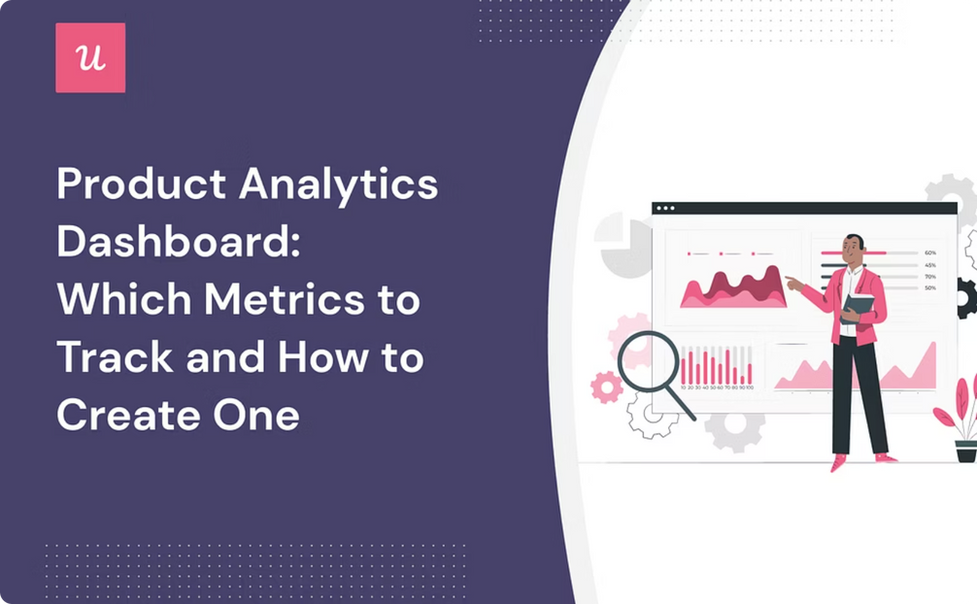
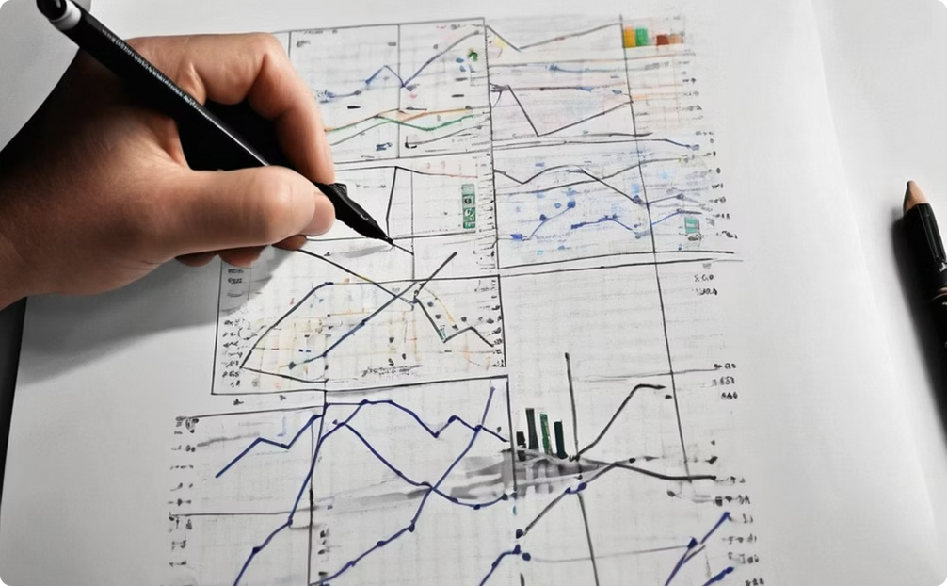
GOLD LAYER
Business-Ready Aggregations
Revenue by Category
Revenue by Event Type
Total revenue aggregated by product category_code for merchandising insights
Revenue grouped by event_type (view, cart, purchase) for funnel analysis
Notes:
7

Slide 8



Gold Layer Tables
Read Silver Table
Apply Aggregations
Save Gold Tables
Load clean data from medallion_db.silver_2019_nov
GroupBy and sum operations for business metrics
Write to gold_revenue_by_category and gold_revenue_by_event
Notes:
8

Slide 9



Day 06 Summary
Layered Architecture
Data Quality
Scalability
Successfully implemented Bronze, Silver, and Gold layers with clear separation of concerns
Ensured reliability through deduplication, validation, and business rule enforcement
Built production-grade pipeline using Delta Lake for ACID transactions and time travel
This Medallion Architecture provides a robust foundation for enterprise data pipelines, enabling teams to maintain data quality while delivering actionable business insights.
Notes:
9

Slide 10
Thank You
Presented by: Ruchi Wange
DATABRICKS |
CODEBASICS |
INDIAN DATA CLUB
Notes:
10

